Slide 1
Chaotic Coder
Hotel Management Application
Created by:
Alexander Boutselis, Ethan Mojahedi, Minas Papazyan, Nura Mouktar

Slide 2
Problems Running a Hotel
M

Slide 3
Problems
Reservation Management:
Difficulty in maintaining accurate booking records.
Double booking or missed reservations.
Customer Data Handling:
Storing customer details securely.
Ensuring easy access for retrieval.
Room Allocation:
Manual or inefficient room assignment processes.
Mismatches between room requirements and availability.
Employee Supervision:
Lack of centralized tracking for employee activities.
Monitoring multiple managerial tasks.
M

Slide 4
Introducing Our Application
M

Slide 5
Our Hotel Management Application
Our hotel management application, is designed to streamline hotel management processes and elevate operational efficiency. It addresses the common challenges in the industry by providing the following functionalities:
Comprehensive Reservation System: Simplified reservation management to avoid overlaps and missed bookings.
Customer Database Integration: Centralized customer data storage for secure and seamless access.
Room Management: Automated room allocation and availability tracking.
Managerial Tools: Employee supervision and performance monitoring tools for managers.
User-Friendly Interface: Intuitive and accessible interface for employees and customers alike.
M

Slide 6

Design of Application
Employee & Admin Features:
Easy hotel setup to virtually represent physical hotel locations.
Track and manage hotel information efficiently.
User-Friendly Design:
Simple interface for potential guests.
View hotel locations and available rooms.
Check current reservations or make new bookings easily.
HotelManager & RoomManager:
Manage the creation and organization of hotels and rooms for administrators.
Hotel & Room Classes:
Object representations of hotels and their rooms, simulating physical hotels.
ReservationManager & Reservation Classes:
Handle creation and management of reservations
Enable users to book rooms and view their existing reservations easily
A
Notes:
Thank you Minas, Our application is designed to accommodate both Hotel Managers, and the Users
Allowing Hotel managers to easily recreate their physical hotels and rooms virtually on our app. *Pause*
This allows Admins the ability to track and manage their hotel data all from one location.
For the Users we designed an easy to use interface that will allow potential guests to view the different hotel locations and their available rooms, as well as check on their existing reservations or make new a new one.
Our application is able to do this by utilizing the Hotel Manager and Room Manager Classes that are in responsible for creating and managing the Hotel and Room objects.
These Hotel and Room objects are the virtual representation of the physical hotel and its rooms.
The other main classes utilized by our application is the Reservation Manager and Reservation Classes. The Reservation Manager handles the creation and management of the Reservation objects which enables users to view their reservations and modify them as needed.

Slide 7
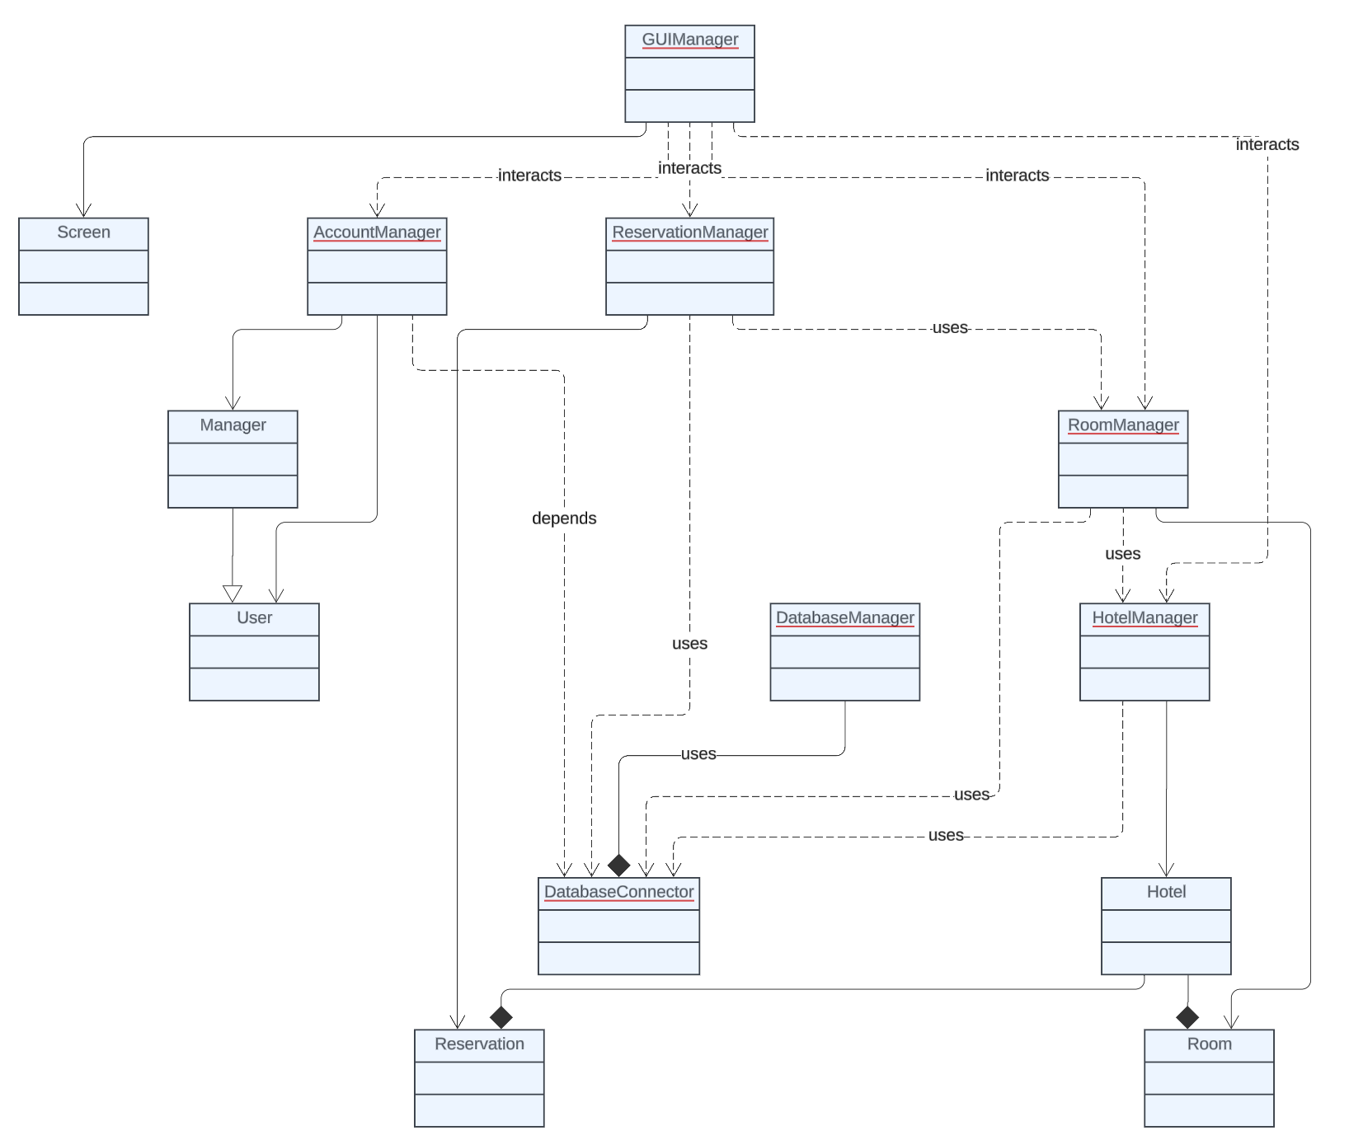
UML Diagram
A
Notes:
This is our simplified UML Diagram for our hotel management system.
Users will interact with the GUIManager and various screens that call the respective Manager classes based on what the user wants to do.
Each Manager Class is in charge of an Object Class,
Account Manager controls Managers and Users, Manager extend Users and have additional privileges
As previously mentioned Hotel Manager and Room Manager work together to control the Hotel and Room objects
And Reservation Manager controls the Reservation Objects.
All of the Manager classes also utilize the Database Manager and Database Connector to Access, Store, and remove data from the database.
Overview: This diagram represents our hotel management system, showing how different classes interact to manage users, hotels, rooms, and reservations. The key components include several manager classes, a database connector, and the user interface manager.
Main Components:
AccountManager: Handles creating, updating, and deleting user accounts, including both User and Manager roles. The Manager class inherits from User.
HotelManager: Manages the creation and updates for Hotel objects, and works closely with RoomManager to add rooms to hotels.
RoomManager: Creates and manages Room objects. Each Hotel is composed of multiple rooms, and RoomManager is responsible for adding them to the correct hotel.
ReservationManager: Handles booking and managing Reservation objects. Reservations are linked to rooms, and this manager works with RoomManager and HotelManager to maintain the booking information.
DatabaseManager: Tracks the current user and hotel, and connects to the database through DatabaseConnector.
DatabaseConnector: Manages all interactions with the database, such as adding, translating, and removing objects like hotels, rooms, users, and reservations.
GUIManager: Handles the visual interface and interacts with all other manager classes to display information on different screens (Screen).
Relationships:
Inheritance: Manager inherits from User, making Manager a specialized type of User.
Composition: Hotel contains Room objects, and DatabaseConnector handles the lifecycle of Reservation and Room objects.
Dependencies: DatabaseConnector is used by other manager classes to interact with the database, while DatabaseManager depends on it to manage data storage.
Interactions: GUIManager interacts with all other manager classes to display data, allowing users to view and modify information.
Summary: In this system, the Manager classes focus on different aspects of hotel management—users, hotels, rooms, and reservations. DatabaseConnector and DatabaseManager help keep all data organized and stored, while GUIManager provides a user-friendly interface to interact with the system. Each component has a specific role, and they work together to make the hotel management process efficient and user-friendly.

Slide 8
Database Schema
A

Slide 9
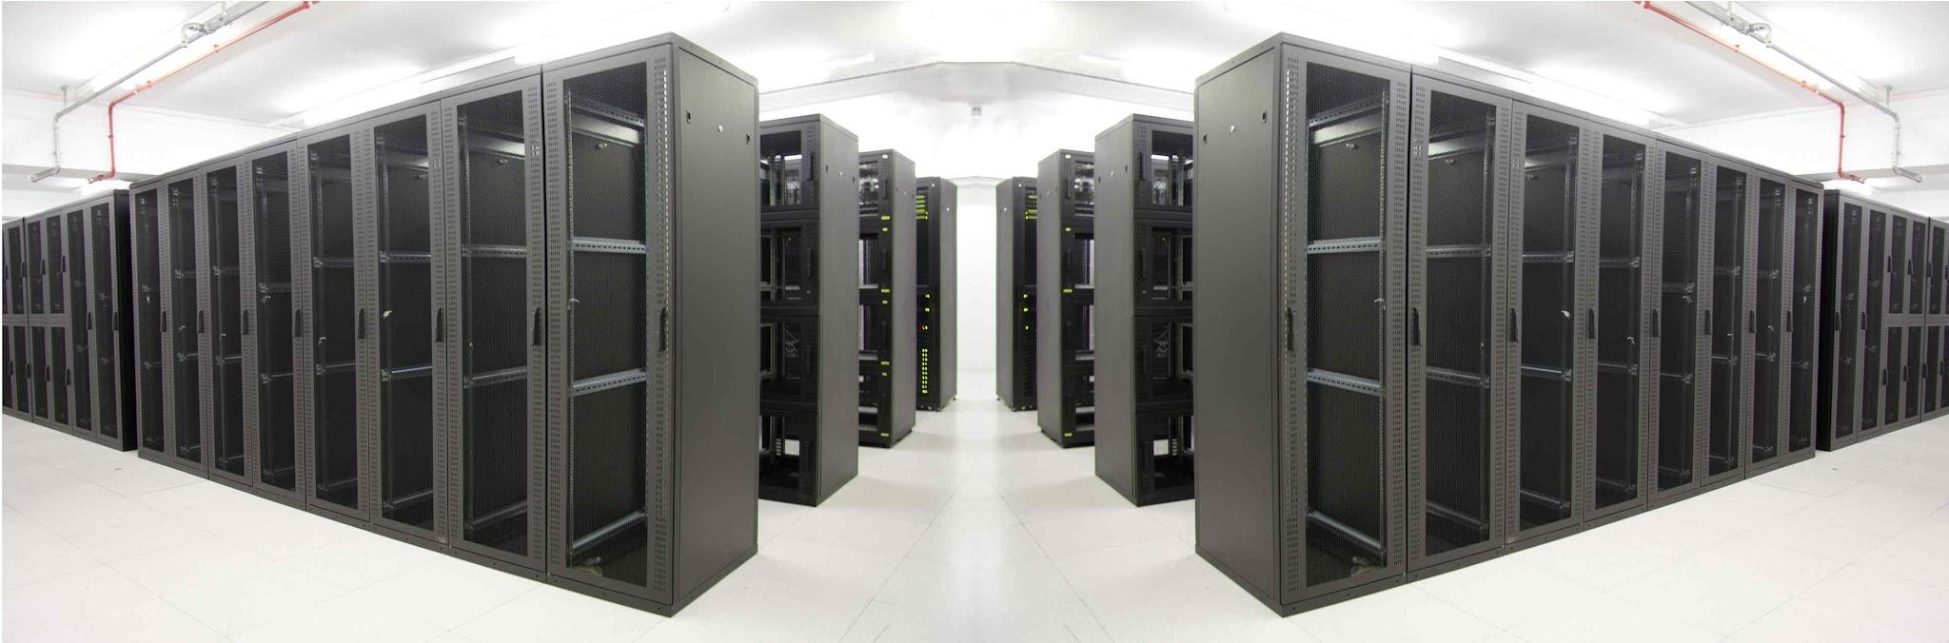
Database Schema
Table Names:
Hotels
Rooms
Users
Reservations
Relationships:
Hotels and Rooms
One-to-Many
Users and Reservations
Many-to-One
Rooms and Reservations
Many-to-One
Hotels and Reservations
Many-to-One
A
Notes:
Our Database Schema utilizes the integrated H2 Database and consists of 4 Tables
Hotels, Rooms, Users, and Reservations
Hotel and Rooms have a one to many relationship because each hotel can have many rooms, but each room can only belong to one hotel
Similarly, Users, Rooms, and Hotels, have a Many-to-One relationship with Reservations because they can all have multiple reservations but each reservation can only designate one User, one Room, and one Hotel.

Slide 10
Key Features
Create Hotels and Rooms
Create a Personalized Account
View all the available Rooms
Easily Place Reservations
Manage your Reservations
Modify or Cancel Reservations
A
Notes:
Overall, the key features of our application are
The ability to Create Hotels and Rooms
Create a Personalized Accounts for Users and Managers
View all the available Rooms across different Hotel locations
Easily Place Reservations
As an administrator you can manage all the hotel Reservations
And as a User you can Modify or Cancel Reservations
Now, I will be passing it off to Ethan for Algorithms and Data Structures.

Slide 11
Algorithms and Data Structures
E

Slide 12
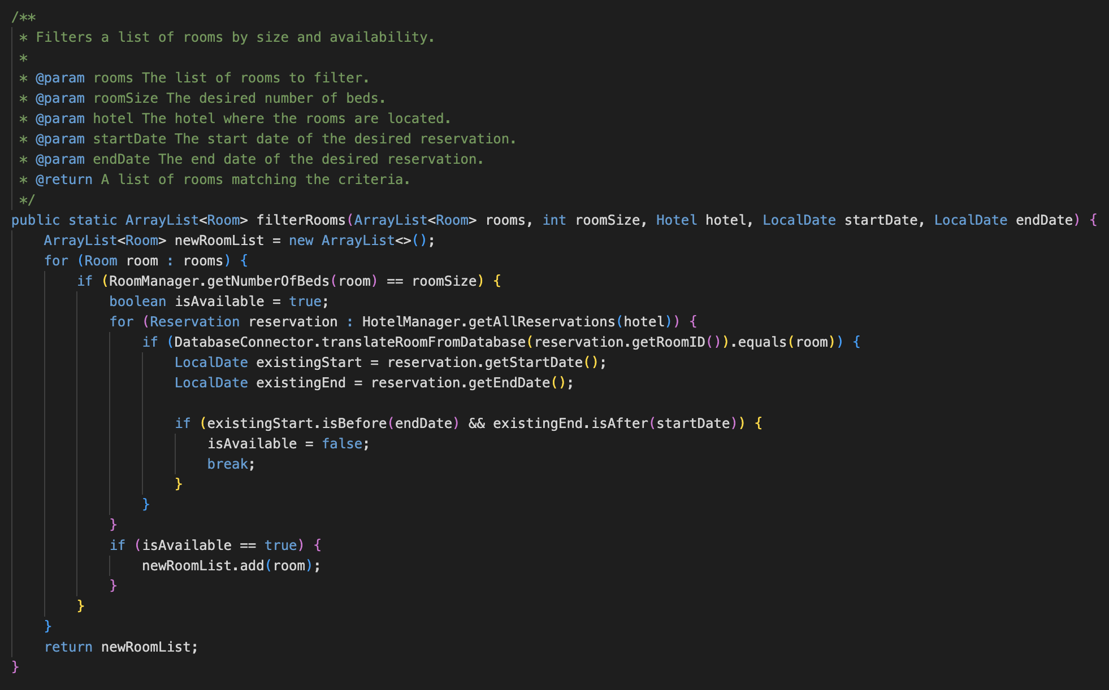
Algorithms
Our application employs several different algorithms
For example, they are used to accomplish the creation of reservations, as a lot of checking has to be done
filterRooms() returns a list of available rooms given a desired room size, start date, and end date
This represents a filtering algorithm along with a nested iteration
E

Slide 13
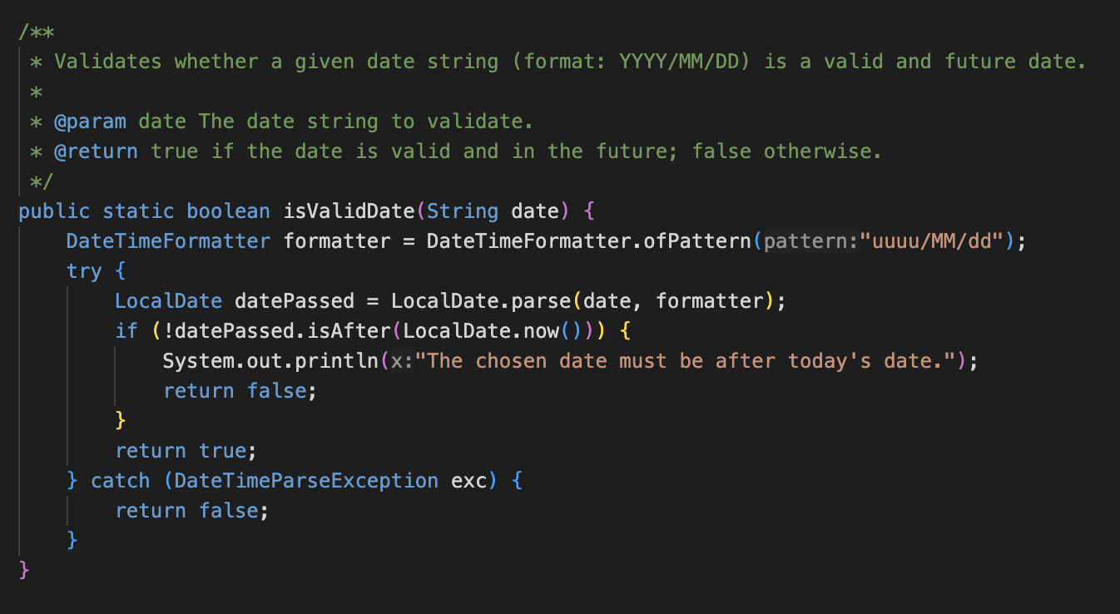
Algorithms continued
isValidDate() checks if an input string is in the format of a valid date YYYY/MM/DD, as in it is after the current date and typed correctly
This represents a date comparison and date parsing algorithm together
E

Slide 14
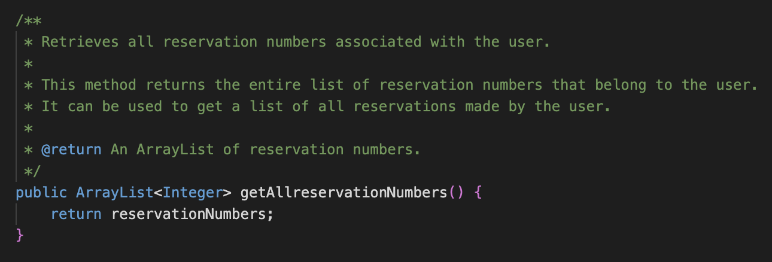
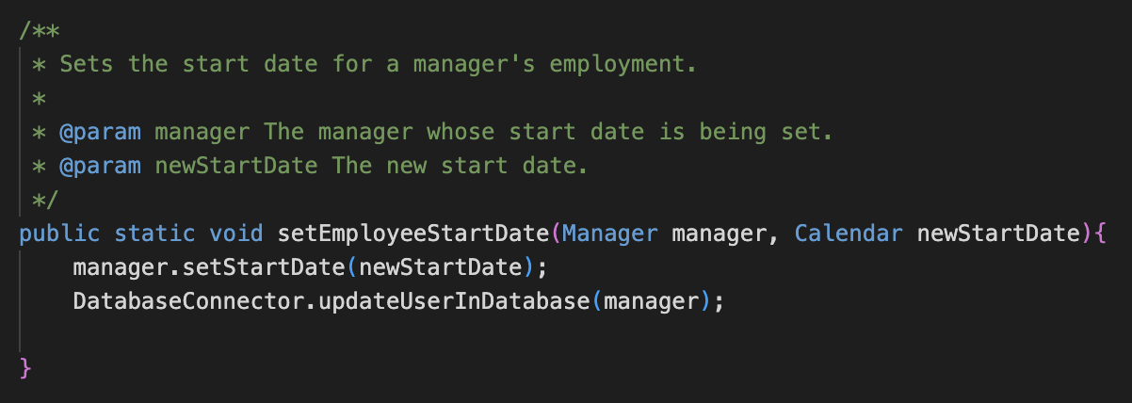
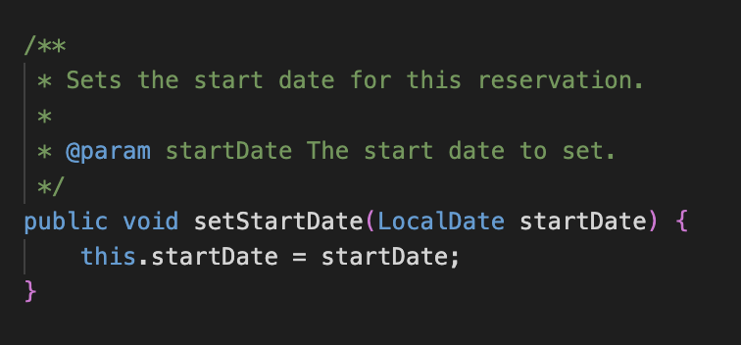
Data Structures
We used arraylists, calendars, and localdates among other data structures
Array lists were used in many ways, but one was for holding reservation numbers for each user for example
Calendars were used for primarily date scheduling
Local dates were primarily used for reservation making - setting the start and end dates
E

Slide 15
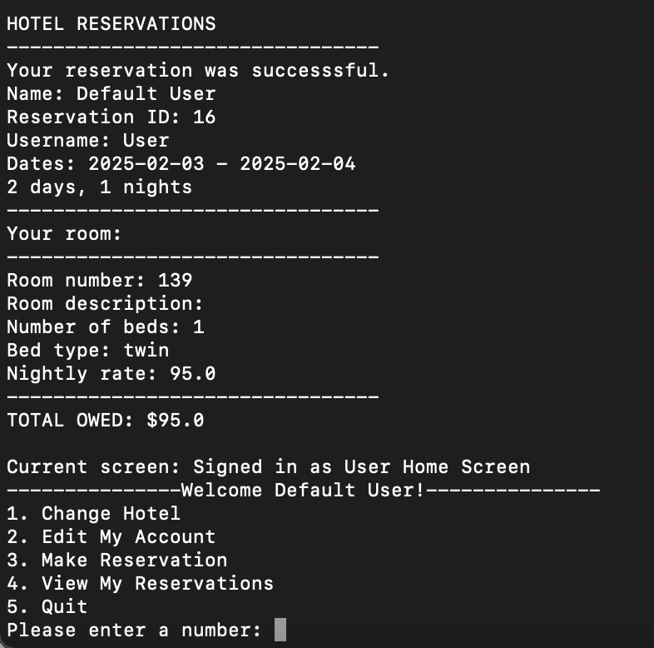
Demonstrating How to Make a Reservation
In current phase of development, users can make reservations in the terminal window
Users will log in, select a hotel, select make reservation, and be prompted with rooms
They will select a room and confirm their reservation
Methods like filterRooms() are used here to make sure room availability is accurate and allow the user to reserve smoothly
E

Slide 16
Navigating the User Interface
N
Notes:
Understand the layout: Menus and navigation bars, search bars, icons and buttons.
Interact with features: clicking and tapping, scrolling, dropdowns and tabs.
Accessibility features: Keyboard shortcut, screen readers, etc
Settings

Slide 17
Challenges We Faced
N

Slide 18
Challenges We Faced
Challenge
Maintaining real-time room availability, booking, and pricing. To avoid overbooking and customer dissatisfaction.
Connection with database
Connecting the screens together
Lack of knowledge for some of the software tools we used
N
Notes:
Some Issue I faced was trying to get AWS database working, ended up being charged money -Alex
Learning Jira -Alex

Slide 19
How We Overcame These Challenges
N

Slide 20
How We Overcame These Challenges
Solution
We integrated the hotel management-system with real-time booking engine to ensure up to date room availability.
Studying and watching videos to learn how to use the software tools we used.
Constant communication among our team members
N
Notes:
Utilized a local database “H2” -Alex

Slide 21
Accomplishments
What We Accomplished
Successfully implemented a comprehensive Hotel Management System.
Designed features like room reservations, user account management, and manager functionalities.
Integrated backend functionality with a user-friendly GUI.
How We Grew as Developers
Enhanced problem-solving skills through real-world application design.
Strengthened team collaboration and task delegation.
Improved coding practices and understanding of Java Swing and database management.
M

Slide 22
Future Implementations and Maintenance
Improved User Experience
Mobile-friendly interface
Multi-language support
Advanced Features
Dynamic pricing
Third-party integrations
Analytics and Scalability
Customer behavior insights
Enhanced security measures
M

Slide 23
Conclusion
Introduced the Chaotic Coder Hotel Management Application, designed to solve real-world problems faced by hotels.
Highlighted its core functionalities, including managing reservations, editing hotel details, and user account management.
Discussed how the application streamlines hotel operations and improves efficiency.
Shared our accomplishments and the learning journey behind the project.
Outlined potential future improvements to enhance the application further.
M

Slide 24
Thank You!

